Slide 1
Programming Data Visualizations that Show Group Comparisons
Module: 5 – Group Comparisons – The Code
DVP
CS7 (continued)

Slide 2
Activity - Experiment with R and Python Code for DVP to Show Group Comparisons
PPTX Companion to CS7 video called:

Slide 3
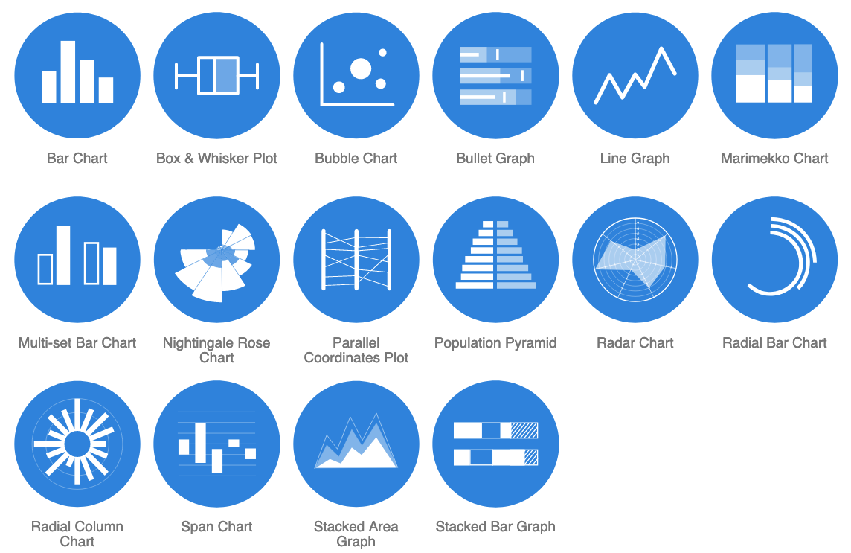

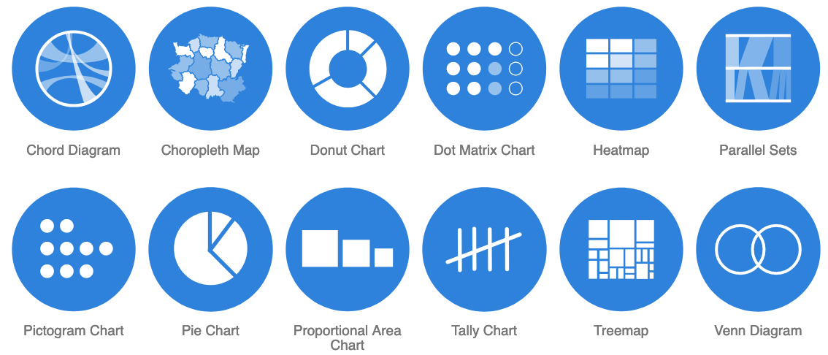
WARNING 1:
For your Assign5, DO NOT use a DV type that you have submitted in a previous module assignment (Assign2 thru Assign4). It will not be considered as a valid Assign5 submission component.
DV types that show Group Comparisons.
Repeat (from "The Theory" PPTX)
Notes:
Source:
https://datavizcatalogue.com/search/comparisons.html

Slide 4
Why?
I need to see that your team is able to create new things (new types of DVs); not things that you have already created and submitted.
Repeat (from "The Theory" PPTX)
Notes:
Source:
https://datavizcatalogue.com/search/comparisons.html

Slide 5



Recall from the Module 5 – Group Comparisons – The Theory PPTX that, in this class session, we will focus on:
Notes:
Source:
https://datavizcatalogue.com/search/comparisons.html

Slide 6
How to create data visualizations that show group comparisons in R:
click on these icons to go to the “How to…” for each in R...
...Or get the URLs from the notes section of this slide.
Notes:
Stacked area:
https://r-graph-gallery.com/stacked-area-graph.html
Stacked bar:
https://www.geeksforgeeks.org/stacked-and-group-bar-charts-in-r/
Heatmap:
https://r-graph-gallery.com/heatmap

Slide 7
How to create data visualizations that show group comparisons in Python:
click on these icons to go to the “How to…” for each in Python...
...Or get the URLs from the notes section of this slide.
Notes:
Stacked area:
https://www.geeksforgeeks.org/how-to-create-an-area-chart-in-seaborn/
Stacked bar:
https://www.geeksforgeeks.org/create-a-stacked-bar-plot-in-matplotlib/
Heatmap:
https://datavizpyr.com/heatmap-with-matplotlib-in-python/

Slide 8
Click on the graphics to the right and explore the Data Visualization Catalogue website options for creating other data visualizations types that show Group Comparisons.
The Data Visualization Catalogue provides an explanation of the anatomy of each DV type, code, and tutorials.
Notes:
Source:
https://datavizcatalogue.com/search/comparisons.html

Slide 9
WARNING 2:
For your Assign5, DO NOT use a DV type that you have submitted in a previous module assignment (Assign2 thru Assign4). It will not be considered as a valid Assign5 submission component.
DV types that show Group Comparisons.
Repeat (from "The Theory" PPTX)
Notes:
Source:
https://datavizcatalogue.com/search/comparisons.html

Slide 10

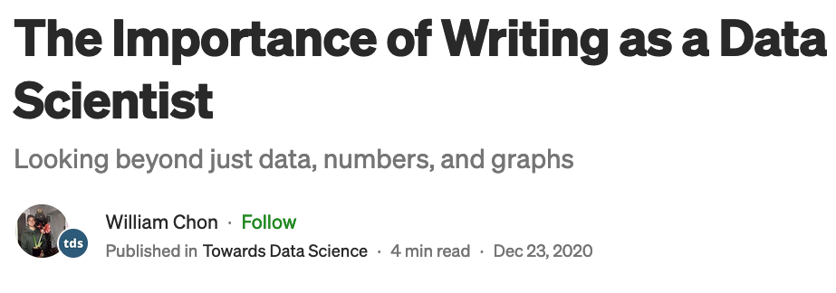
Remember the importance of data insights
Suggested Readings:
Click the graphics to go to the articles or get the URLs from the notes section of this slide.
Notes:
Suggested readings:
1. https://emeritus.org/in/learn/why-communication-skills-are-important-for-a-data-analyst/
2. https://towardsdatascience.com/the-importance-of-writing-as-a-data-scientist-22feb2b1d33d

Slide 11



Click the graphics to go to the website or get the URL from the notes section of this slide.
Notes:
Source:
https://web.saumag.edu/writing-center/

Slide 12


Data Visualizations – Group Comparisons
How to program data visualizations that show Group Comparisons in R.
How to program data visualization that show Group Comparisons in Python.

Slide 13
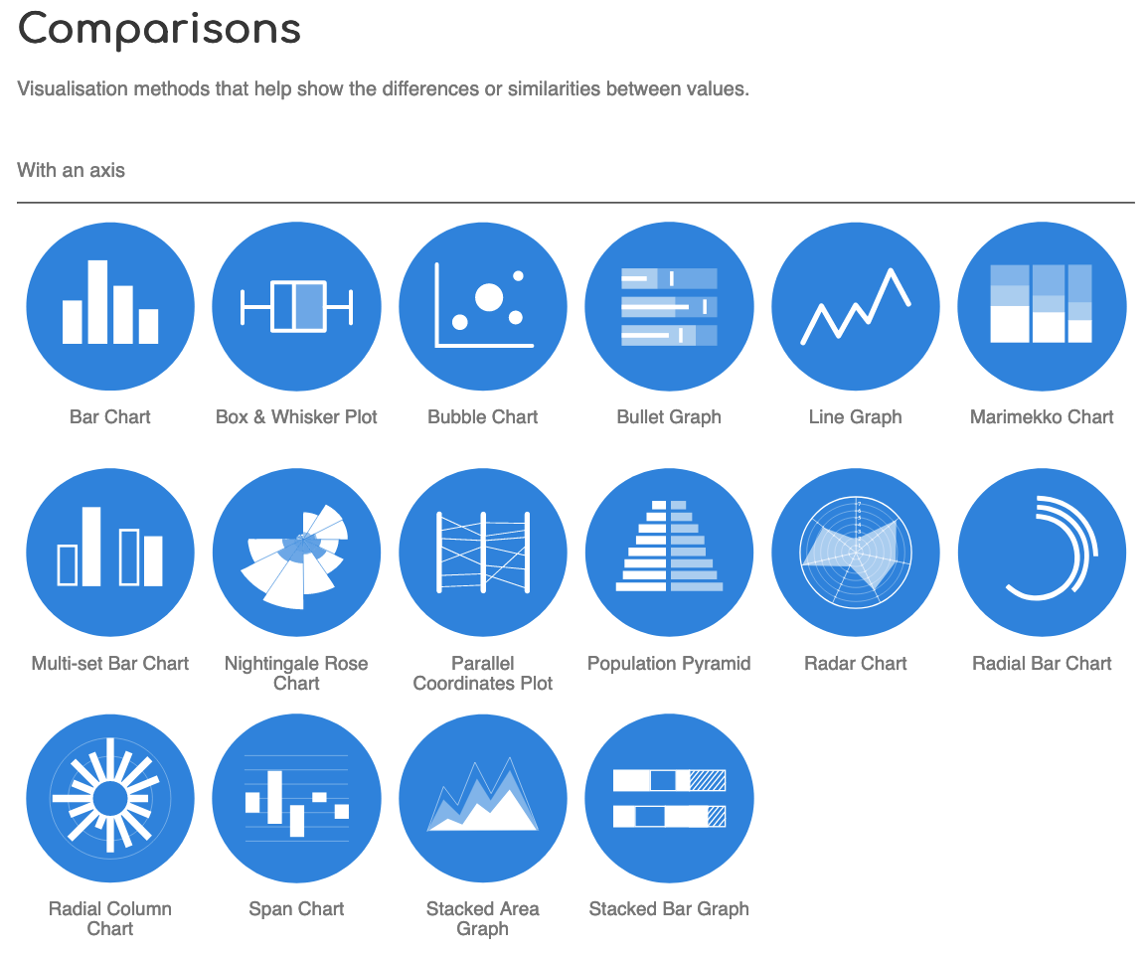
:Ways to visualize Group Comparisons
Notes:
Source:
https://datavizcatalogue.com/search/comparisons.html

Slide 14
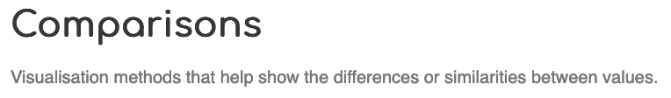
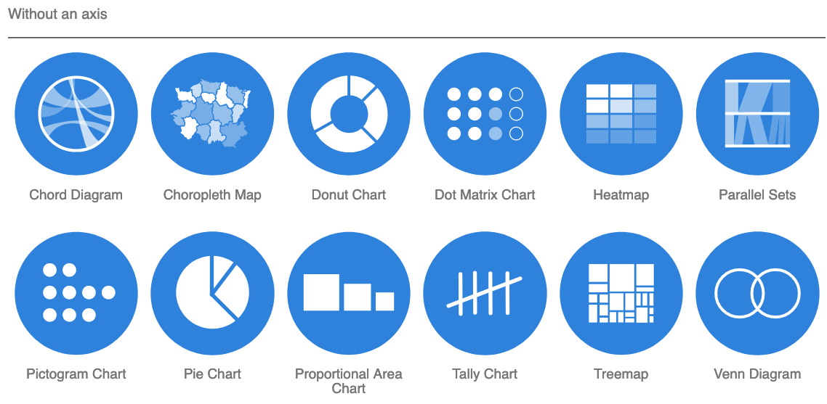
:Ways to visualize Group Comparisons
Notes:
Source:
https://datavizcatalogue.com/search/comparisons.html

Slide 15
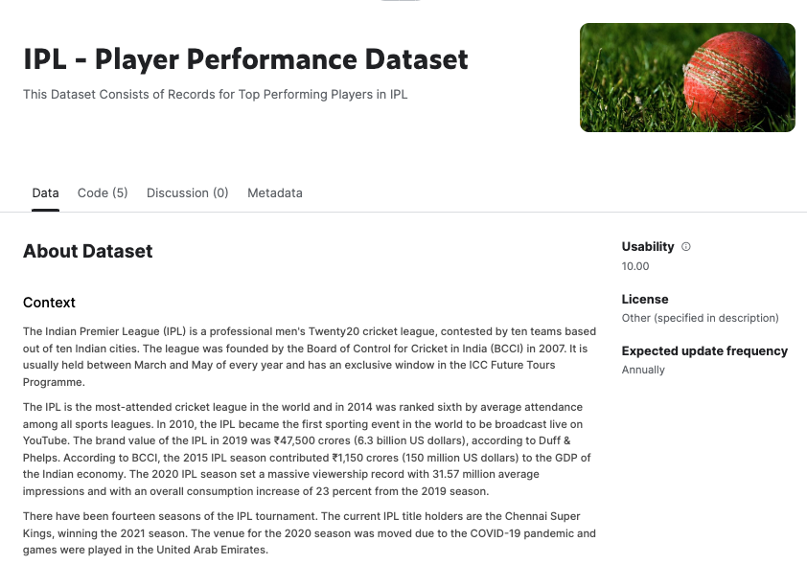
Example Dataset
Dataset for M5 In-Class Exercises
Class_Session_7_Activity.csv
Get dataset file from CS7 Bb folder (once available).
Notes:
Dataset source:
https://www.kaggle.com/datasets/iamsouravbanerjee/ipl-player-performance-dataset?resource=download

Slide 16
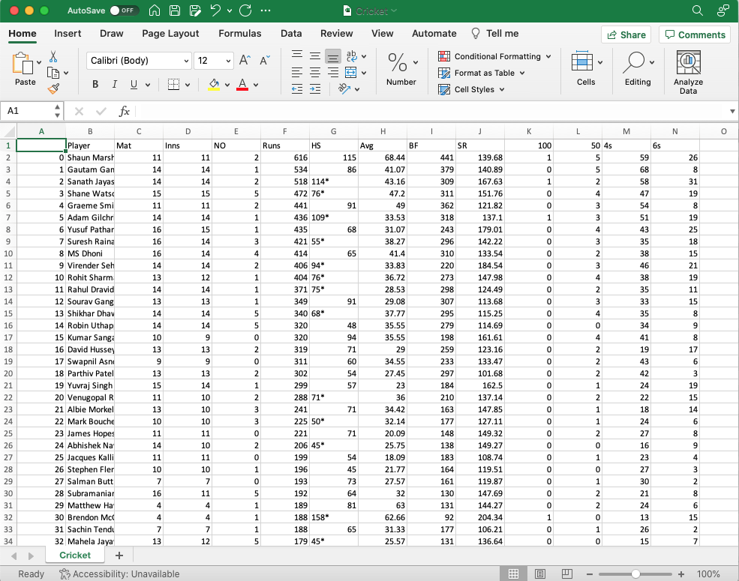
Dataset for M5 Class Session 7 Activity
Class_Session_7_Activity.csv
Read the important content in the notes section of this slide (only visible when download and open this PPTX file).
Notes:
Dataset source:
https://www.kaggle.com/datasets/iamsouravbanerjee/ipl-player-performance-dataset?resource=download
“Most Runs All Seasons Combine.csv” but Dr. Mead changed the name to "Class_Session_7_Activity.csv".
We can write code to sort the dataset on the "Avg" column as one step in taking a subset of just the Top 20 players based on the Avg performance metric:
https://en.wikipedia.org/wiki/Batting_average_(cricket)
We can also write code to remove the * from the HS column.

Slide 17
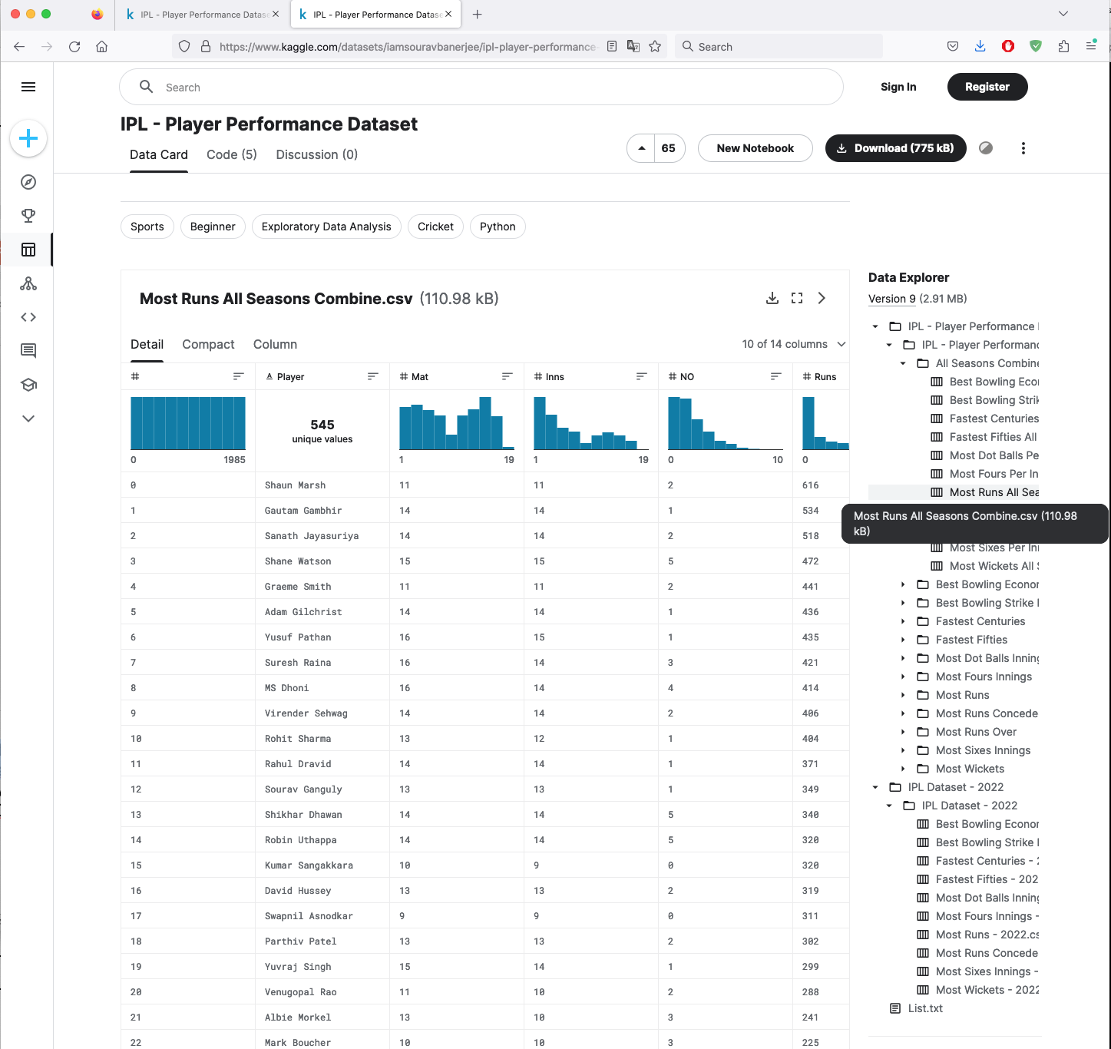
Dataset for M5 Class Session 7 Activity
Class_Session_7_Activity.csv

Slide 18
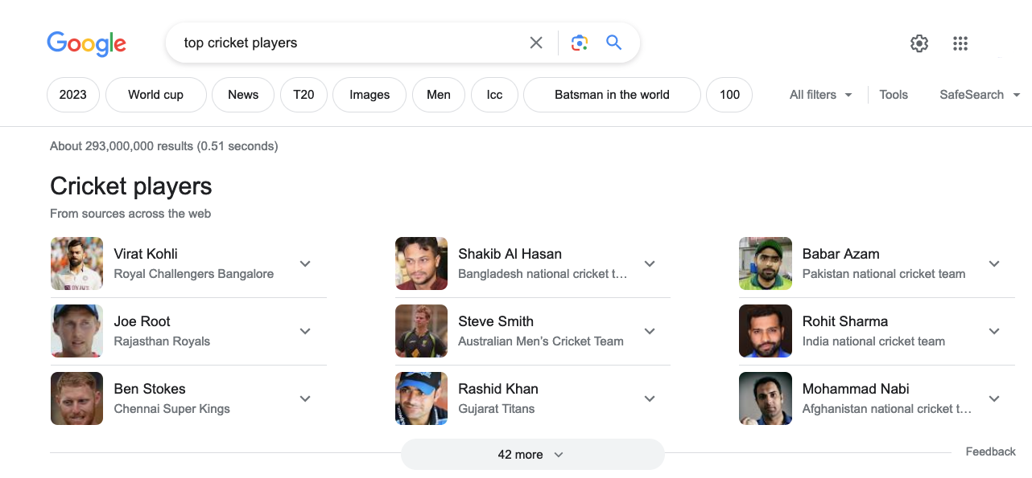
Example Use Case
Class_Session_7_Activity.csv
A new brand of sports drink wants to hire a top cricket player to be their "celebrity endorser" for their product so that they can increase sales. They want to select three players to approach with a potential deal. Which three players are good candidates to suggest to the company and why?

Slide 19
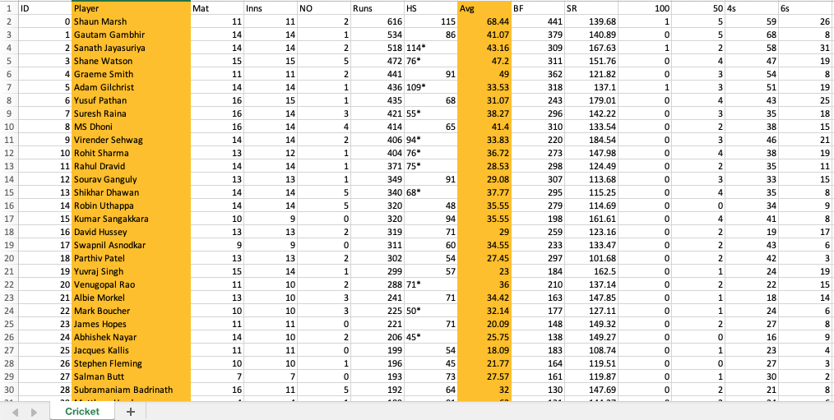
Dataset for M5 Class Session 7 Activity
Class_Session_7_Activity.csv
Read the important content in the notes section of this slide (only visible when download and open this PPTX file).
Using DVP Programming, we could sort the dataset on the "Avg" column descending (from largest to smallest) as one step in taking a subset of just the Top 20 players based on the Avg performance metric.
Notes:
Using DVP Programming, we could sort the dataset on the "Avg" column descending (from largest to smallest) as one step in taking a subset of just the Top 20 players based on the Avg performance metric:
https://en.wikipedia.org/wiki/Batting_average_(cricket)
This slide shows a view of the dataset before it has been sorted descending on the Avg column. We will execute this sort operation using Python and R code.

Slide 20
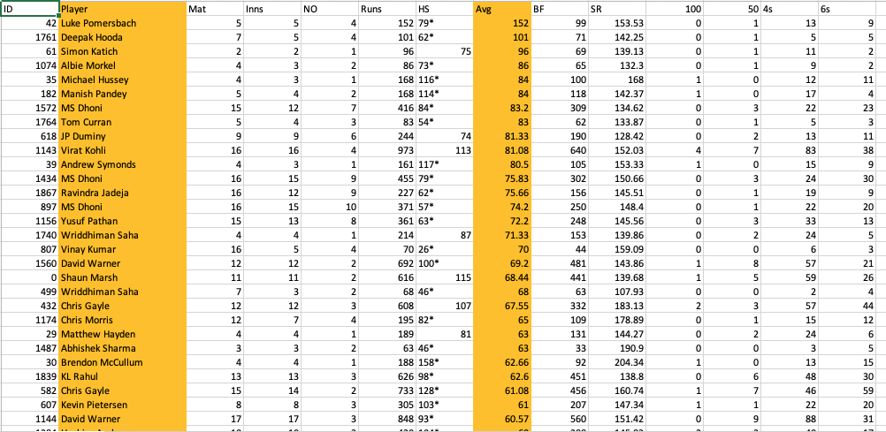
Dataset for M5 Class Session 7 Activity
Class_Session_7_Activity.csv
Read the important content in the notes section of this slide (only visible when download and open this PPTX file).
Here is the view of the dataset after it has been sorted descending on the Avg column. We will execute this sort operation using R and Python code.
Notes:
Using DVP Programming, we could sort the dataset on the "Avg" column descending (from largest to smallest) as one step in taking a subset of just the Top 20 players based on the Avg performance metric:
https://en.wikipedia.org/wiki/Batting_average_(cricket)
This slide shows a view of the dataset after it has been sorted descending on the Avg column. We will execute this sort operation using Python and R code.

Slide 21
Data Distributions in R
At this point, follow the demonstration steps Dr. Mead showcases in the "Activity - Experiment with R and Python Code for DVP to Show Group Comparisons" video in the "Class Session 7" folder on Blackboard.

Slide 22

Our process for programming data visualizations in R.
Create an R Markdown document (.Rmd) "R codebook"
Insert code and documentation lines and optimize them as we go along
Install packages if required
Load libraries
Import data
Explore the data
Do some data processing
Define variables
Create additional variables if needed
Create data visualizations (DVs)
Save DVs as stand-alone image files
Insert DVs into a report document and write data insights
Download completed R codebook
Students in this course are required to do R exercises in the RStudio Cloud web-based environment:
https://login.rstudio.cloud/login?redirect=%2F

Slide 23

This time, we will perform some additional data processing in R.
1) Remove weird characters (like *) from a column
2) Sort descending (highest to lowest)
3) Deal with rows that have repeat values (but are not duplicates)
4) Take a subset of the top n rows based on a column

Slide 24
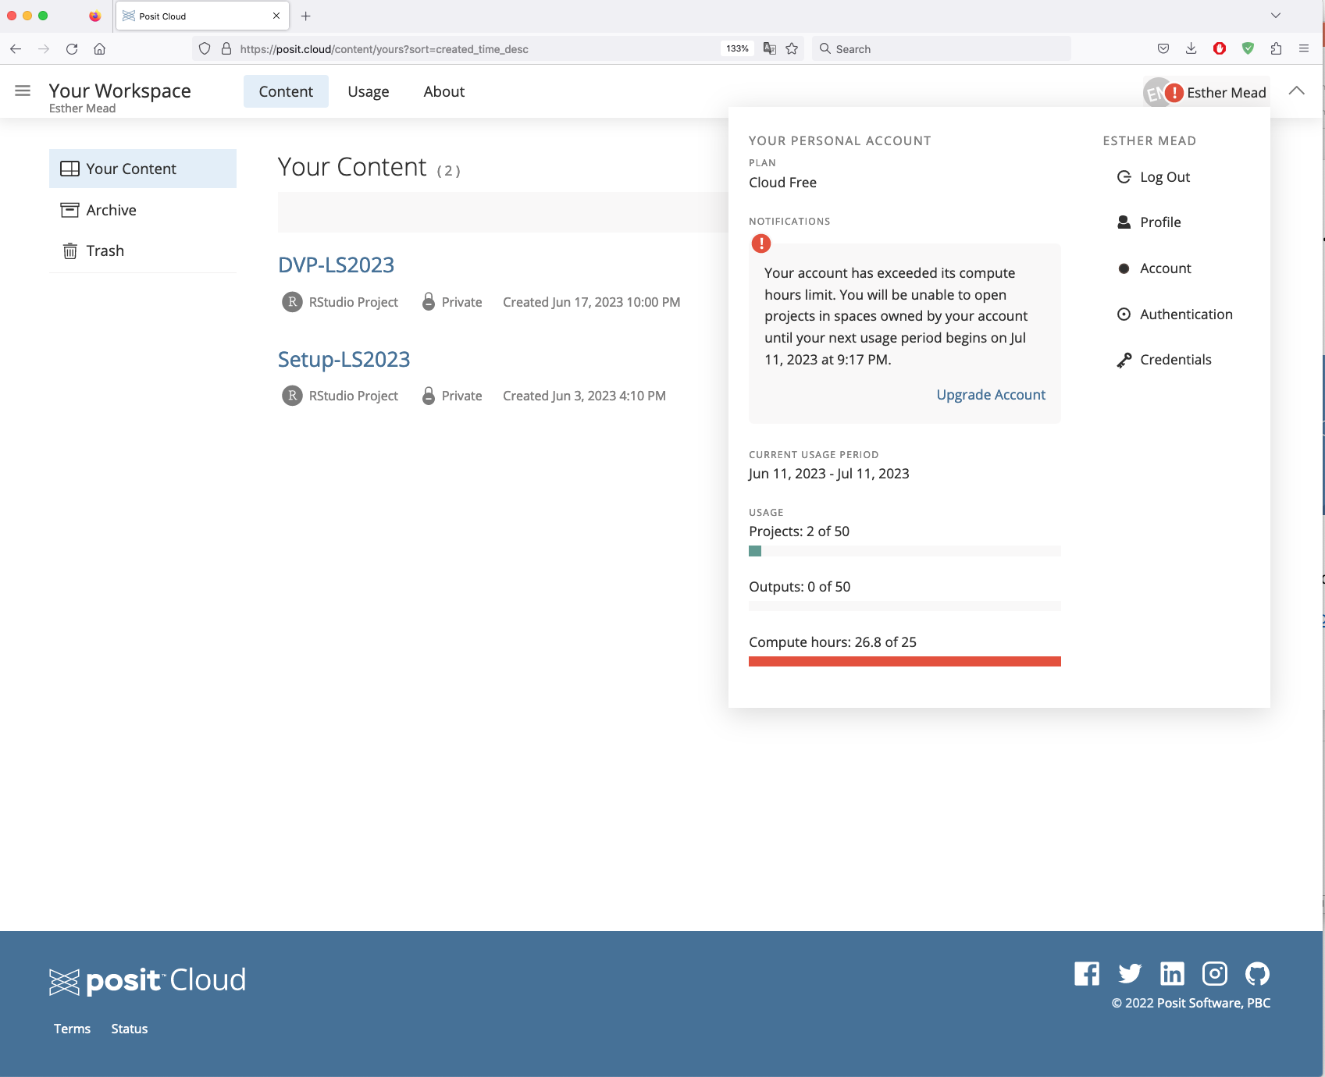
If you encounter the "Your account has exceeded its compute hours limit" prompt in RStudio Cloud:
If you encounter the "Your account has exceeded its compute hours limit" prompt in RStudio Cloud, simply log in using another Gmail account.

Slide 25
If you encounter the "Your account has exceeded its compute hours limit" prompt in RStudio Cloud:
NOT an acceptable excuse for late or failed submissions. All teams are treated equally.
If you encounter the "Your account has exceeded its compute hours limit" prompt in RStudio Cloud, simply log in using another Gmail account.

Slide 26
Data Distributions in Python
At this point, follow the demonstration steps Dr. Mead showcases in the "Activity - Experiment with R and Python Code for DVP to Show Group Comparisons" video in the "Class Session 7" folder on Blackboard.

Slide 27


Our process for programming data visualizations in Python.
Create Python notebook (.ipynb)
Insert code and documentation lines and optimize them as we go along
Import libraries (install items as needed)
Import data
Explore the data
Do some data processing
Define variables
Create additional variables if needed
Create data visualizations (DVs)
Save DVs as stand-alone image files
Insert DVs into a report document and write data insights
Download completed Python codebook
Students in this course are required to do Python exercises in the JupyterLite web-based environment:
https://jupyter.org/try-jupyter/lab/

Slide 28

This time, we will perform some additional data processing in Python.
1) Remove weird characters (like *) from a column
2) Sort descending (highest to lowest)
3) Deal with rows that have repeat values (but are not duplicates)
4) Take a subset of the top n rows based on a column

Slide 29
Reminder (from "The Theory" slides) of additional resources for: How to create data visualizations that show group comparisons in R:
click on these icons to go to the “How to…” for each in R...
...Or get the URLs from the notes section of this slide.
Notes:
Stacked area:
https://r-graph-gallery.com/stacked-area-graph.html
Stacked bar:
https://www.geeksforgeeks.org/stacked-and-group-bar-charts-in-r/
Heatmap:
https://r-graph-gallery.com/heatmap

Slide 30
Reminder (from "The Theory" slides) of additional resources for: How to create data visualizations that show group comparisons in Python:
click on these icons to go to the “How to…” for each in Python...
...Or get the URLs from the notes section of this slide.
Notes:
Stacked area:
https://www.geeksforgeeks.org/how-to-create-an-area-chart-in-seaborn/
Stacked bar:
https://www.geeksforgeeks.org/create-a-stacked-bar-plot-in-matplotlib/
Heatmap:
https://datavizpyr.com/heatmap-with-matplotlib-in-python/

Slide 31
Also a reminder: You can explore the Data Visualization Catalogue website options for creating other data visualizations types that show Group Comparisons.
The Data Visualization Catalogue provides an explanation of the anatomy of each DV type, code, and tutorials.
Notes:
Source:
https://datavizcatalogue.com/search/comparisons.html

Slide 32
WARNING 3:
For your Assign5, DO NOT use a DV type that you have submitted in a previous module assignment (Assign2 thru Assign4). It will not be considered as a valid Assign5 submission component.
DV types that show Group Comparisons.
Repeat (from "The Theory" PPTX)
Notes:
Source:
https://datavizcatalogue.com/search/comparisons.html

Slide 33
WARNING 4:
For your Assign5, DO NOT use a DV type that you have submitted in a previous module assignment (Assign2 thru Assign4). It will not be considered as a valid Assign5 submission component.
I need to see that your team is able to create new things (new types of DVs); not things that you have already created and submitted.
Repeat (from "The Theory" PPTX)

Slide 34
Equal contribution:
A reminder that all team members are required to make an equal contribution towards team project components. A score of zero (0) will be posted for individual team members who fail to make an equal contribution towards team project components.
Repeat (from "The Theory" PPTX)

Slide 35
Preventing Academic Dishonesty and Integrity Violations
Recall previous communications regarding the SAU Academic Dishonesty and Integrity Policy.
Any instances of Academic Dishonesty and Integrity violations 1) will be reported to the SAU Authorities, 2) will result in a score of zero (0), 3) may result in receiving a grade of "F" in the course, and 4) may result in your expulsion from the university.
Example:
Submitting work created by another (current or previous) student.
Submitting work created by another (current or previous) team.

Slide 36
End of file.

